Slide 1

School of Electrical Engineering and Computer Science
Department of Electrical Engineering
EE-371 : Control Systems
Lecture#18
6.1 Introduction
6.2 Routh-Hurwitz Criterion
Textbook: Chapter # 06 (5th edition)
Text Book: Control Systems Engineering by Norman S. Nise 5th Edition
Instructor: Ms Neelma Naz
Class: BEE 12 C/D

Slide 2
Stability
Textbook: Chapter # 06 (5th edition)
Text Book: Control Systems Engineering by Norman S. Nise 5th Edition
6.1 Introduction

Slide 3
Introduction
Control systems analysis and design focus on three specifications:
transient response
stability
steady-state errors

Slide 4
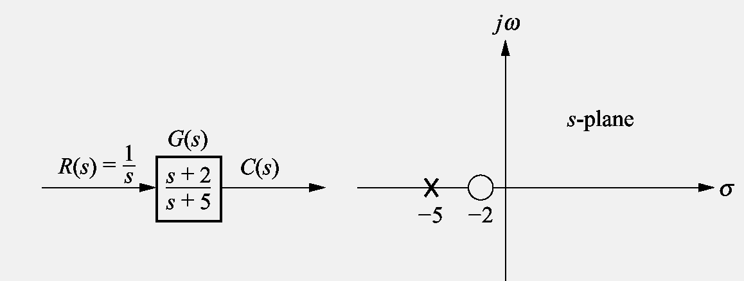
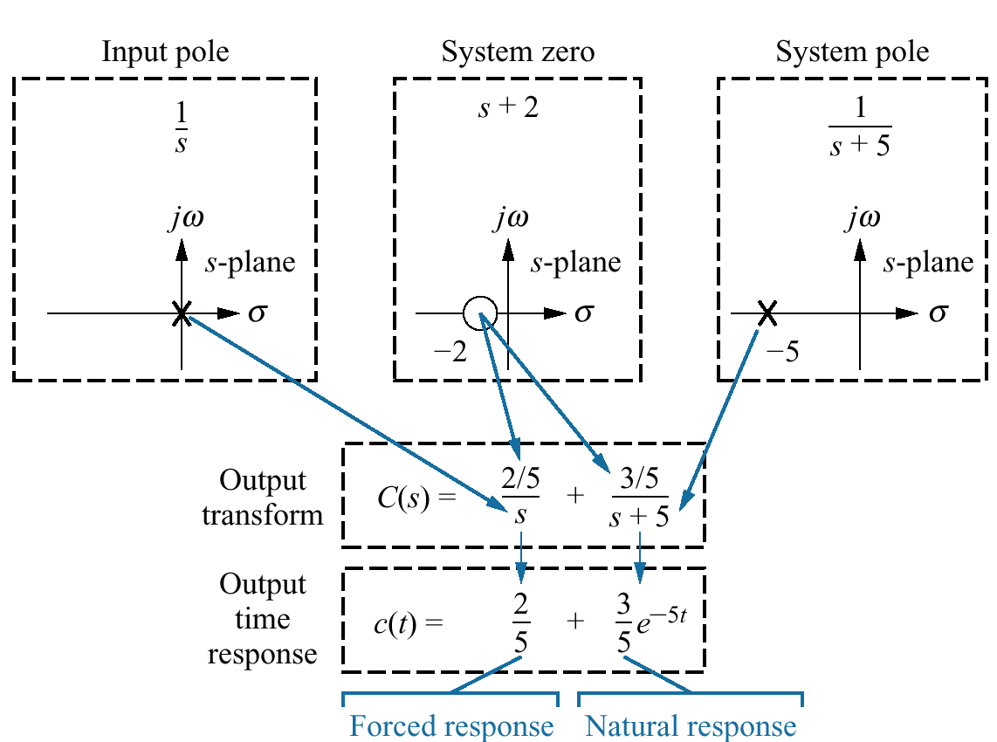
We can control the output of a system
if
the steady-state response consists of
only the forced response
The system is stable
The total response of a system is sum of the forced and natural responses
c(t) = c_{forced}(t) + c_{natural}(t)
Transient and steady state responses of a system can be controlled only if the system is stable

Slide 5
Definitions
(from natural response perspective )
Stability : A linear, time-invariant system is stable if the natural response approaches zero as time approaches infinity.
Instability : A linear, time-invariant system is unstable if the natural response grows without bound as time approaches infinity.
Marginal Stability : A linear, time-invariant system is marginally stable if the natural response neither decays nor grows but remains constant or oscillates as time approaches infinity.

Slide 6
Definitions
(from total response perspective)
A system is stable if every bounded input yields a bounded output.
(bounded-input, bounded-output (BIBO) definition of stability)
2. A system is unstable if any bounded input yields an unbounded output.

Slide 7
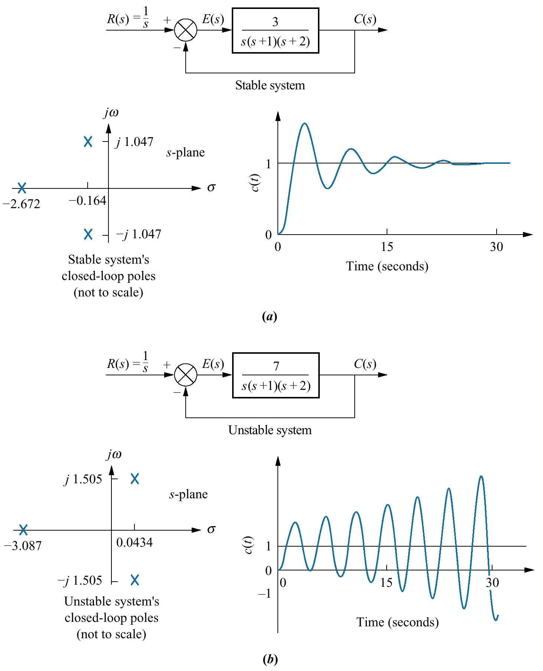

Slide 8
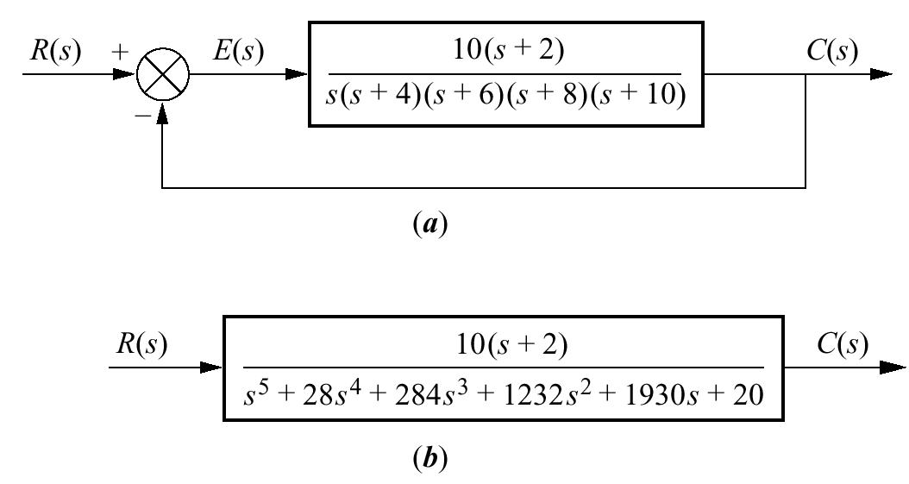
Cause of problems in finding closed-loop poles:
Poles for the forward TF are known
Closed-loop system
We need to factorize the characteristic polynomial to find roots of the closed-loop TF
equivalent system

Slide 9
Location of the poles of the closed-loop system are not known unless the characteristic polynomial is factored or otherwise solved for the roots.
Some conclusions can be drawn about the stability of the system.
If the transfer function has poles only in the left-half-plane, then the factors of the denominator consist of products of terms:
s + a_{i}
a_{i} is real and positive, or complex with a positive real part
The product of terms a_{i} is a polynomial with all positive coefficients
No term of the polynomial can be missing
(no cancellation between positive and negative coefficients in the factors)

Slide 10
A sufficient condition for a system to be unstable is that all signs of the coefficients of the denominator of the transfer function are not the same.
If powers of s are missing, the system is either unstable or marginally stable
If all coefficients of the denominator are positive and not missing, we are uncertain about the system's pole locations
How can we find about stability of the system if all coefficient are greater than zero ????

Slide 11
Routh-Hurwitz Criterion
The Routh-Hurwitz criterion for stability is a method that yields stability information without the need to solve for the closed-loop system poles.
The criterion gives the number of roots with positive real parts, and does not give the exact value of the roots.
Therefore this stability criterion gives us the absolute stability analysis, determining if any poles are in the RHP or on the jw axis.
The method requires two steps:
(1) Generate a data table called a Routh table
(2) Interpret the Routh table to tell how many system poles are in the left half-plane, in the right half-plane, and on the jω-axis

Slide 12
X
Relatively More Stable
Absolutely Stable

Slide 13
X
Relatively Less Stable
Absolutely Stable
Note: No change in Absolute stability – no pole(s) location

Slide 14
Absolutely Stable
Unstable
Note: From Stable to unstable

Slide 15
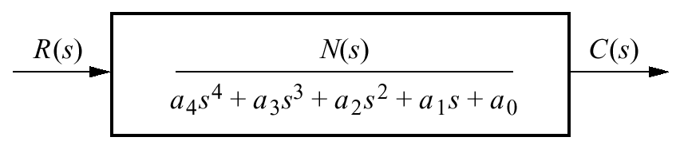
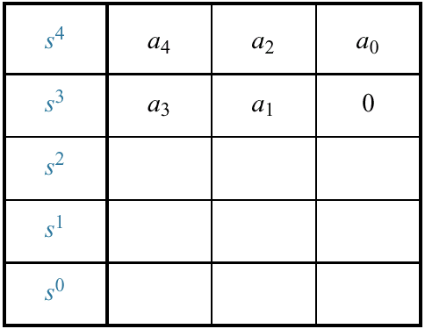
Closed-loop transfer function
Routh-Hurwitz Criterion
Initial layout for Routh table

Slide 16
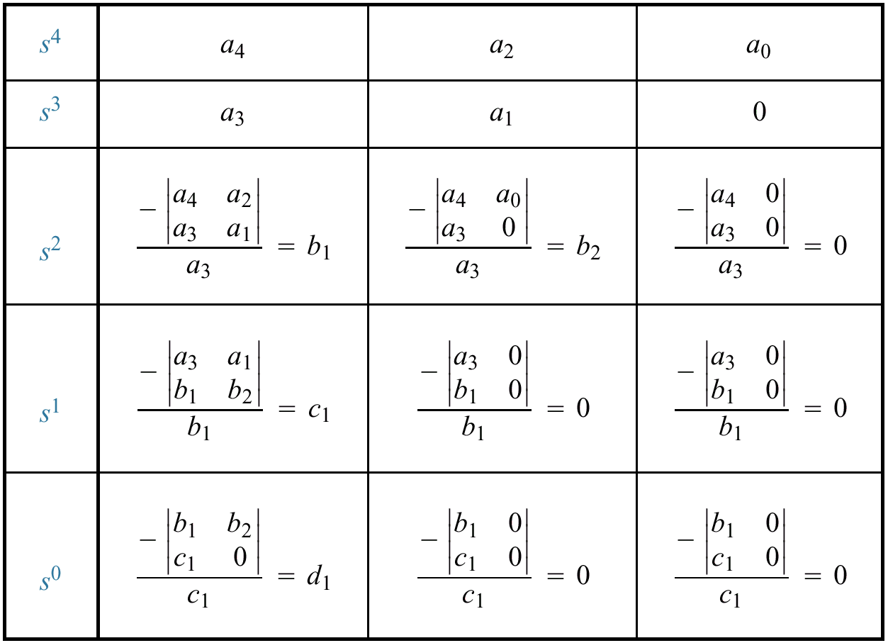
Completed Routh table

Slide 17
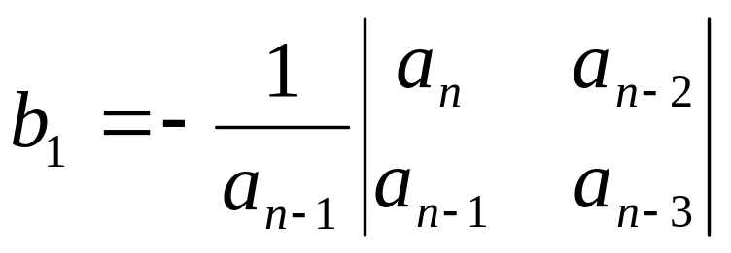

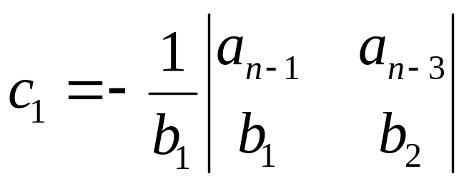
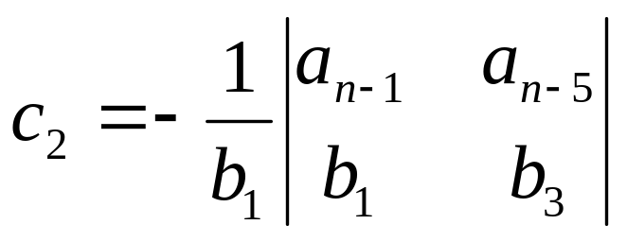
First step make the Routh Array:
s^{n} a_{n} a_{n-2} a_{n-4} a_{n-6} ……
s^{n-1} a_{n-1} a_{n-3} a_{n-5} a_{n-7} ……
s^{n-2} b₁ b₂ b₃ b₄ ……
s^{n-3} c₁ c₂ c₃ c₄ ……
. .
. .
. .
s² k₁ k₂
s¹ l₁
s⁰ m₁

Slide 18
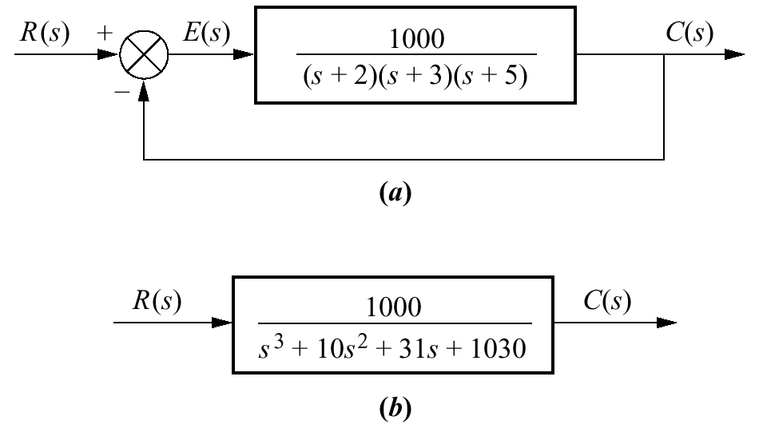
Example 6.1
Make the Routh table for the system shown in the Figure.
Feedback system
SOLUTION
Find the equivalent closed-loop system because we want to test the denominator of the closed-loop transfer function.
How the transfer function is found ???
Equivalent closed-loop system

Slide 19
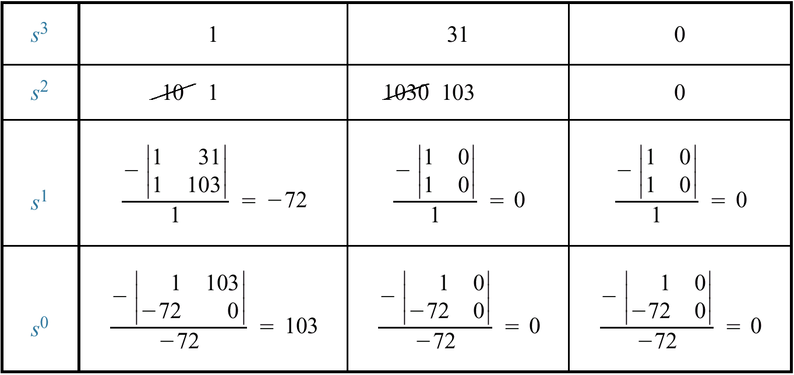
Make a Routh Table and label the rows with powers of s from s³ down to s⁰ in a vertical column
Form the first and second row using the coefficients of the Polynomial.
Elements of subsequent rows are computed from the entries of the preceding rows
Completed Routh table

Slide 20
s³ | 1 | 31 | 0
s² | 1 | 103 | 0
s¹ | -72 | 0 | 0
s⁰ | 103 | 0 | 0

Slide 21
Interpreting the Basic Routh Table
The basic Routh table applies to systems with poles in the left and right half-planes
The Routh-Hurwitz criterion declares that the number of roots of the polynomial that are in the right half-plane is equal to the number of sign changes in the first column of Routh Table.
s³ | 1 | 31 | 0
s² | 1 | 103 | 0
s¹ | -72 | 0 | 0
s⁰ | 103 | 0 | 0
How many sign changes in this Routh table ???

Slide 22
Assignment
PROBLEM:
Make a Routh table and tell how many roots of the following polynomial are in the right half-plane and in the left half-plane.

Slide 23
Stable,
Unstable, and
Marginally Stable Systems
Examples:

Slide 24
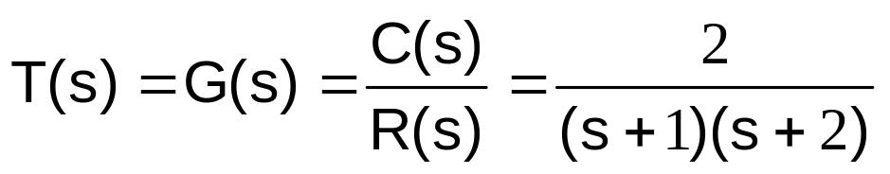
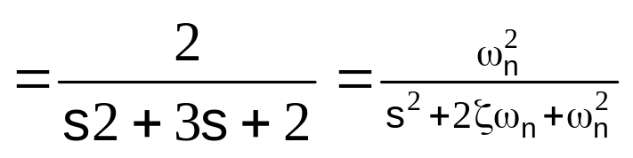
Example:1
Stability
Stable or Unstable?
S-plane
Characteristic equation (s+1)(s+2)=0
x
x
-2
-1
Hence s+1=0 or s=-1
and s+2=0 or s=-2
The natural-response terms for the system are k₁e^{-t} and k₂e^{-2t}

Slide 25
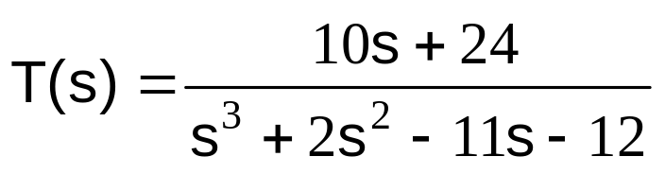
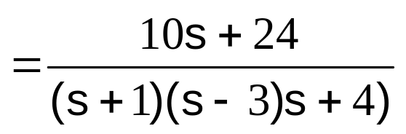
Example 2:
Hence roots are s= -1, s= 3, & s= -4
Stable or Unstable?
Unstable due to s=3
The natural-response terms for the system are k₁e^{-t} , k₂e^{3t}, and k₃e^{-4t}
Unstable due to term k₂e^{3t}
MATLAB Program:
x
x
x
-4
-2.4
-1
3
>> p = [1 2 -11 -12];
>> r = roots(p)
Note: Numerator 10s+24 has NO role in the stability of the system

Slide 26
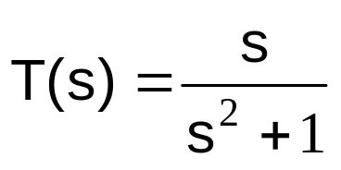
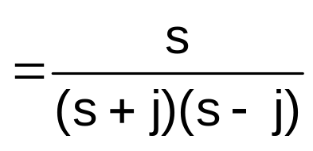
Example:3
Hence roots are s= -j, s= j
x
j
Stable or Unstable?
Marginally stable
x
-j
The natural-response terms for the system are ksin(t+θ)
Marginally stable because no exponential term
MATLAB Program:
>> p = [1 0 1];
>> r = roots(p)

Slide 27
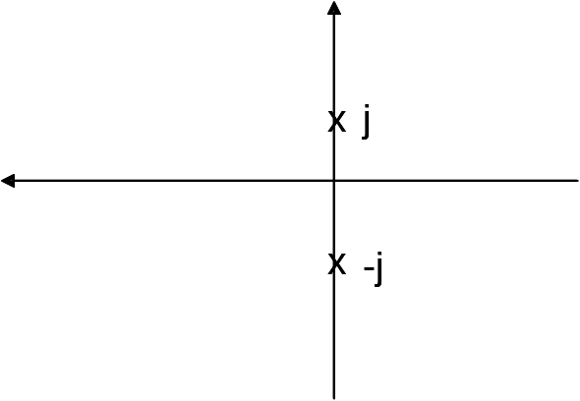
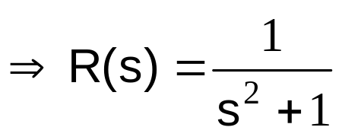
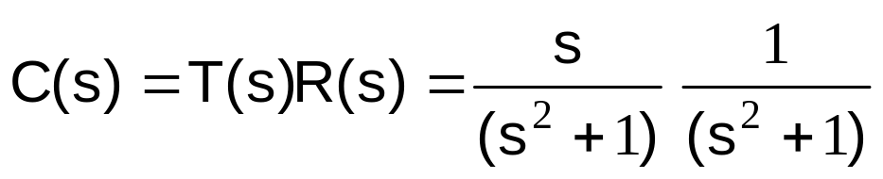
Example:4
Hence roots are s= -j, s=j
Marginally stable
Let the input r(t) = sint
The response of the system c(t) = t sint
Stable or Unstable?
Unstable due to t
sint is marginally stable but the multiplication of time (t) makes it unstable
NOTE: The natural-response of the system are ksin(t+θ) bounded (marginally stable) but produce unbounded output (unstable) for certain bounded input

Slide 28
Routh-Hurwitz Criterion: Special Cases
Zero Only in the First Column
Entire Row is Zero

Slide 29
Case 2
(Zero element in first column)
Un-stable system

Slide 30
Example1: (Case 2)
Q(s) = s⁵ + s⁴ + 2s³ + 3s² + s + 4
s⁵ 1 2 1
s⁴ 1 3 4
s³ -1 -3
s²
0

Slide 31
Case 2 (Steps)
1. First Element of a row is Zero (0)
2. Replace “0” by small number ε. (ε=0.00000000..01)
3. Continue the array

Slide 32
Example1: (Case 2)
Q(s) = s⁵ + s⁴ + 2s³ + 3s² + s + 4
s⁵ 1 2 1
s⁴ 1 3 4
s³ -1 -3
s² ε 4
s¹ (4-3 ε )/ε
s⁰ 4
0
RHP=2
LHP=3
IA = 0
Two sign changes whether ‘ε’ was
assumed +ve or –ve.
UNSTABLE SYSTEM

Slide 33
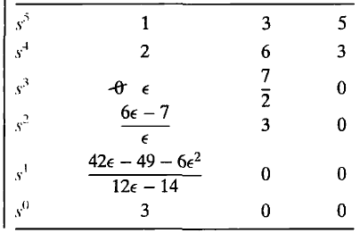
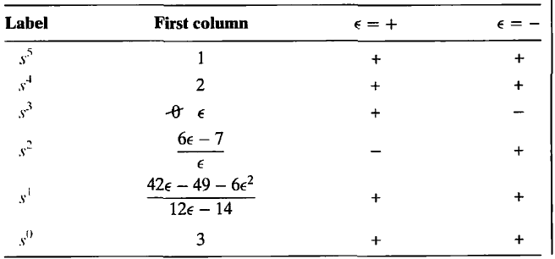
Example2: (Case 2)
Q(s) = s⁵ + 2s⁴ + 3s³ + 6s² + 5s +3
Routh Table: Sign changes in first column
Two sign changes whether ‘ε’ was
assumed +ve or –ve.
UNSTABLE SYSTEM

Slide 34
Case 3
(All Element of a row are Zero
(Premature Termination )

Slide 35

???

